Slide 1


An IR-based Semantic Search approach on Portable Document Format (PDF) files using Similarity Measure
University of Santo Tomas
Institute of Information and Computing Sciences
A Thesis Project
Proponents:
Agsunod, John Mark Robert M.
Banting, Carl Jayson M.
Brar, Harjit S.
Cunanan, Patrick Bryan F.
Thesis Advisor:
Ms. Charmaine S. Ponay
Thesis Coordinator:
Assoc. Prof. Perla Cosme
November 23, 2017

Slide 2


Introduction
The idea of searching is changing.
Then and Now
Tim-Berners Lee (1989)
New Technology
AI
Neural Networks
Natural Language Searching

Slide 3
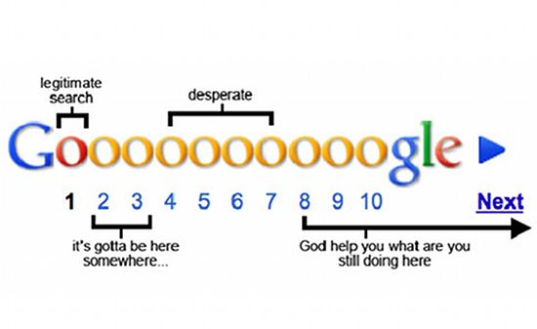
Introduction
In order to cope with this rapid data growth, techniques were created to find information that the user needed as swiftly and accurately as possible. One of the developed search techniques is information retrieval.
IR is a technique that mixes computer science and information science.

Slide 4
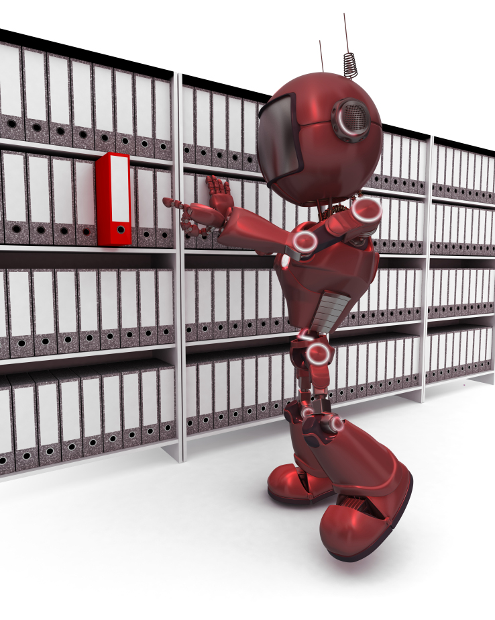
Introduction
Information retrieval (IR) is finding material, usually documents, of an unstructured nature, usually text, that satisfies an information need from within large collections, usually stored on computers.
IR systems are designed to analyze, process and store sources of information and retrieve those that match the user’s query.

Slide 5
Introduction
Current System
Ki-Joo Hong and Han-Joon Kim’s “A semantic search technique with Wikipedia-based text representation model”
Aims to disambiguate terms by comparing terms with concepts
PROBLEM: Efficiency. Uses all of the concepts.
Proposed System
BCAB’s “An IR-based Semantic Search approach on Portable Document Format (PDF) files using Similarity Measure”
SOLUTION: Create result pool, reduced concepts by limiting
AIM: Faster system while maintaining the existing system’s accuracy.

Slide 6

Statement of the problem
The study would look into these problems:
What is the actual time of the researchers’ study on documents related to technology specific to Word Disambiguation, Information Extraction, Image Processing, Data Compression, and Semantic Search compared to the actual time of the existing study?
What is the accuracy of the retrieved documents as compared to the accuracy of the approach of the existing study?

Slide 7
System architecture
Creation and Search Phases

Slide 8
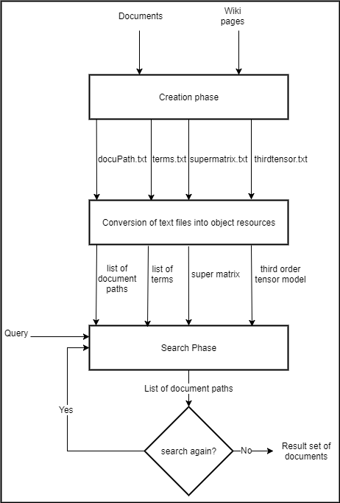
System Architecture of the System

Slide 9
Creation Phase

Slide 10
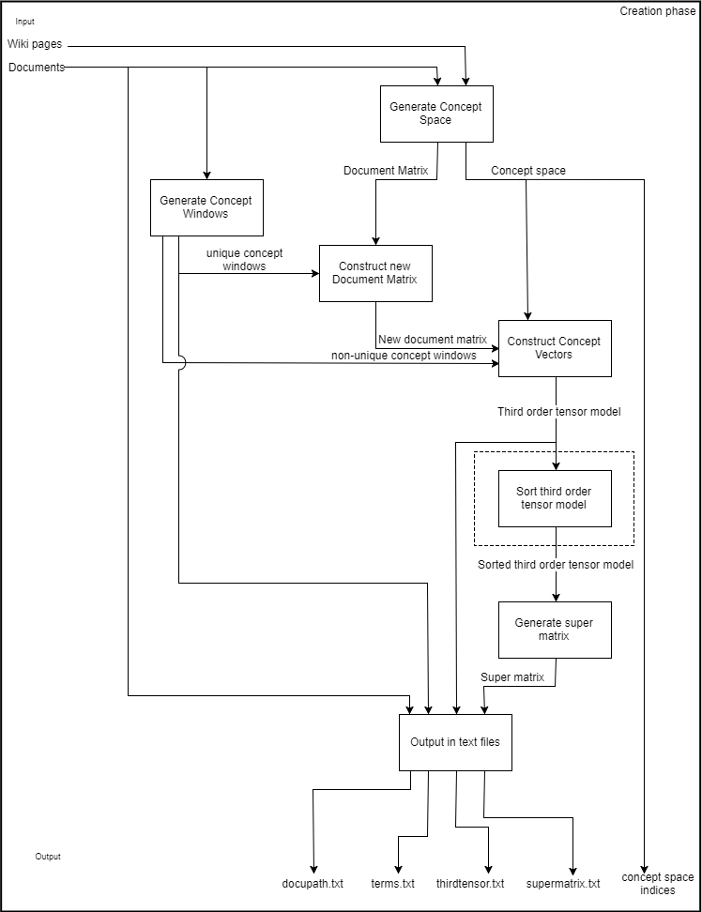
Level-2 System Architecture of the System (Creation Phase)

Slide 11
Search phase

Slide 12
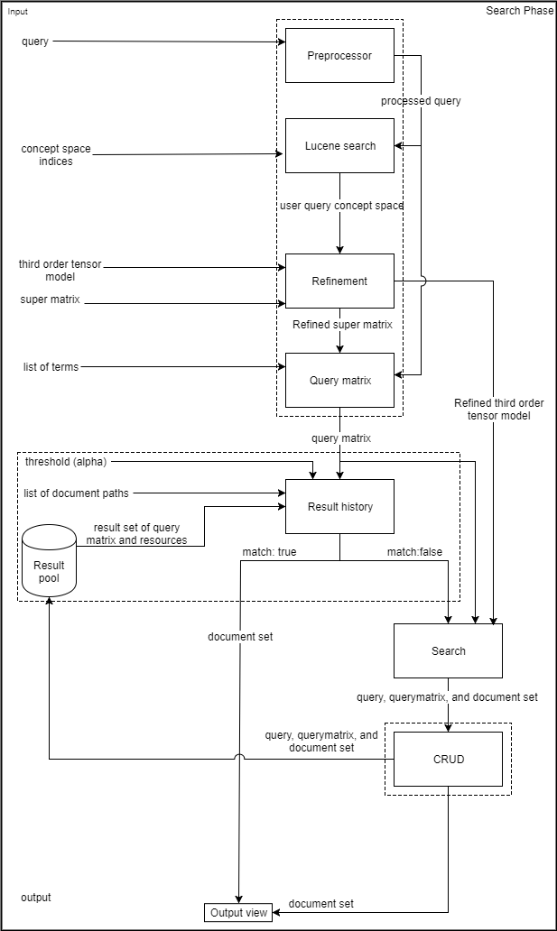
System Architecture of the System (Search Phase)

Slide 13
System demonstration

Slide 14
Presentation and Analysis of Data and Test Results

Slide 15
Table IV‑3. Comparison of Actual Running Time (Original and Implemented)
 | Original (sec) | Implemented (sec)
Average Actual Running Time | 11.882 | 6.56
Table IV‑4. Comparison of Actual Running Time (With RP and Without RP)
 | Without Result Pool(sec) | With Result Pool (sec)
Average Actual Running Time | 10.136 | 3.547

Slide 16
Table IV‑33. T-Statistic & Critical One-tailed Value (Set A)
 | Set A_{Original} | Set A_{implemented}
Mean | 11.883 | 6.560
Observations | 25 | 25
Alpha | 0.05
t-Statistic | 8.139
Critical One-Tailed Value | 1.711
Reject the null hypothesis
Limiting the third tensor model also limits the process of searching through the model
Table IV‑34. T-Statistic & Critical One-tailed Value (Set B)
 | Set B_{with RP} | Set B_{without RP}
Mean | 10.136 | 3.547
Observations | 25 | 25
Alpha | 0.05
t-Statistic | 10.245
Critical One-Tailed Value | 1.711
Reject the null hypothesis
The implemented feature of limiting the 3rd-order tensor model and super matrix, is more efficient compared with the gathered running time of using Set B in a system, where it only has a feature of limiting or refining the 3rd-order tensor model and super matrix and the process of retrieving document set is done by searching through 3rd-order tensor model.

Slide 17
Table IV‑35. Computation of Space Complexity for the Creation Phase
Module | Original | Implemented
Concept Space | O((D∙T)+D+C) | O((D∙T)+D+C)
Concept Window | O(D∙(T∙9)) | O(D∙(T∙9))
Concept Vector | O(D∙T∙C) | O(D∙T∙C)
Tensor Sort | N/A | O(C)
Super Matrix | O(D∙T∙C) | O(D∙T∙C)
Total | O((D∙T)+D+C)+O(D∙(T∙9)) +O(2(D∙T∙C)) | O((D∙T)+D+C)+O(D∙(T∙9)) +O(C)+O(2(D∙T∙C))
The implemented system needs an addition O(C) space.

Slide 18
Analysis
Table IV‑15. Average Precision, Recall, and F1-Measure of Set A
 | Original |  |  | Implemented
Category | Average Precision | Average Recall | Average F1-Measure | Average Precision | Average Recall | Average F1-Measure
Data Compression | 0.98408 | 0.98408 | 0.98408 | 0.98408 | 0.98408 | 0.98408
Image Processing | 0.95934 | 0.90557 | 0.92468 | 0.95934 | 0.90557 | 0.92468
Information Extraction | 0.98719 | 0.88500 | 0.91794 | 0.98719 | 0.88500 | 0.91794
Semantic Search | 0.99743 | 0.96502 | 0.97979 | 0.99743 | 0.96502 | 0.97979
Word Disambiguation | 0.95025 | 0.90229 | 0.92270 | 0.95025 | 0.90229 | 0.92270
Overall Average | 0.97566 | 0.92839 | 0.94584 | 0.97566 | 0.92839 | 0.94584

Slide 19
Table IV‑37. MSE Scores for Precision scores (Set A_{original} & Set A_{implemented})
Table IV‑38. MSE Scores for Recall scores (Set A_{original} & Set A_{implemented})
Category | Q₁ | Q₂ | Q₃ | Q₄ | Q₅
Data compression | 0 | 0 | 0 | 0 | 0
Word disambiguation | 0 | 0 | 0 | 0 | 0
Image processing | 0 | 0 | 0 | 0 | 0
Information extraction | 0 | 0 | 0 | 0 | 0
Semantic search | 0 | 0 | 0 | 0 | 0
Category | Q₁ | Q₂ | Q₃ | Q₄ | Q₅
Data compression | 0 | 0 | 0 | 0 | 0
Word disambiguation | 0 | 0 | 0 | 0 | 0
Image processing | 0 | 0 | 0 | 0 | 0
Information extraction | 0 | 0 | 0 | 0 | 0
Semantic search | 0 | 0 | 0 | 0 | 0
Table IV‑39. MSE Scores for F1 scores (Set A_{original} & Set A_{implemented})
Category | Q₁ | Q₂ | Q₃ | Q₄ | Q₅
Data compression | 0 | 0 | 0 | 0 | 0
Word disambiguation | 0 | 0 | 0 | 0 | 0
Image processing | 0 | 0 | 0 | 0 | 0
Information extraction | 0 | 0 | 0 | 0 | 0
Semantic search | 0 | 0 | 0 | 0 | 0
Error using mean square error measurement,
ε = 0%, for precision
ε = 0%, for recall
ε = 0%, for f1 score
No improvement in accuracy
Indicates that the proposed algorithm of limiting the third tensor model does not affect the result
Model was arranged from highest to lowest

Slide 20
Table IV‑28. Average Precision, Recall, and F1-Measure of Set B
 | Set B |  |  | Set B’
Category | Average Precision | Average Recall | Average F1-Measure | Average Precision | Average Recall | Average F1-Measure
Data Compression | 0.99014 | 0.94112 | 0.96311 | 0.60233 | 0.60721 | 0.59889
Image Processing | 0.92432 | 0.80303 | 0.82183 | 0.31042 | 0.40094 | 0.31711
Information Extraction | 0.98276 | 0.88873 | 0.92223 | 0.73532 | 0.72756 | 0.70743
Semantic Search | 0.99150 | 0.96564 | 0.97766 | 0.77824 | 0.69707 | 0.72741
Word Disambiguation | 0.95766 | 0.95766 | 0.95766 | 0.77766 | 0.78315 | 0.77195
Total Average | 0.96928 | 0.91124 | 0.92850 | 0.64079 | 0.64319 | 0.62456

Slide 21
Analysis
Table IV‑40. MSEs of Eval Scores from Queries (Data Compression
Table IV‑41. MSEs of Eval Scores from Queries (Image Processing)
Scores | Mean square error (MSE)
Precision | 0.1790
Recall | 0.1656
F1 | 0.1733
Scores | Mean square error (MSE)
Precision | 0.498828
Recall | 0.369432
F1 | 0.416042
Table IV‑42. MSEs of Eval Scores from Queries (Information Extraction)
Table IV‑43. MSEs of Eval Scores from Queries (Semantic Search)
Scores | Mean square error (MSE)
Precision | 0.105199
Recall | 0.134242
F1 | 0.079913
Scores | Mean square error (MSE)
Precision | 0.09134
Recall | 0.164092
F1 | 0.137053
Table IV‑44. MSEs of Eval Scores for Queries (Word Disambiguation)
Scores | Mean square error (MSE)
Precision | 0.04968
Recall | 0.041404
F1 | 0.043261

Slide 22
Summary of Findings
The summary of findings discovered and analyzed from the previous section are as follows:
The system with the refinement module offers same accuracy with the original system but it is more efficient in terms of actual running time.
The system with the result history module offers low accuracy as compared to the original system where the searching through the 3rd-order tensor model is processed.
The similarity metric and method used in the result history module depends on lexical matching. Thus, it cannot detect synonym words.
The creation phase with the sorting module needs more space than the original system

Slide 23
CONCLUSION
The accuracy of the proposed system stayed the same
The actual time or speed is decreased by 30%
The proposed system garnered a mean square error of 0.0136 or 1.36%

Slide 24
RECOMMENDATIONS
If further improvements are to be made on this research study, the proponents would like to recommend the following notes and opinions:
Instead of utilizing the metric used by the proponents, use other third party metrics such as Semilar.
Provide adjustments on the algorithms, either by simplifying or enhancing, in order to acquire better speed and accuracy in the search process.
Provide adjustments on the algorithms being utilized in order to acquire better results on the evaluation tools used such as precision and recall, along with the F1-measure.
Utilize a more specific algorithm other than that used by the proponents.
Take into consideration other file types other than PDF files.
Consider including sentences with special symbols such as hyphens, commas, semicolons, etc.
Limit database by finding a metric that chooses database records to remove.

